Slide 1
3D Resort
In OpenGL 3.3
Course No: CSE 4208
Course Name: Computer Graphics Laboratory
Presented By:
Sourav Majumder
Roll: 18099
Year: 4th
Semester: 2nd

Slide 2
Contents
Introduction
Objectives
Features
Conclusion

Slide 3
Introduction
A 3D resort model using opengl 3.3
OpenGL 3.3 uses Shader-Based architecture
Featuring textures mapping
Featuring Curve model.

Slide 4
Objective
To learn how to use opengl 3.3 to draw 3D model
To learn how to complex design
To learn Curve
To learn texture mapping

Slide 5
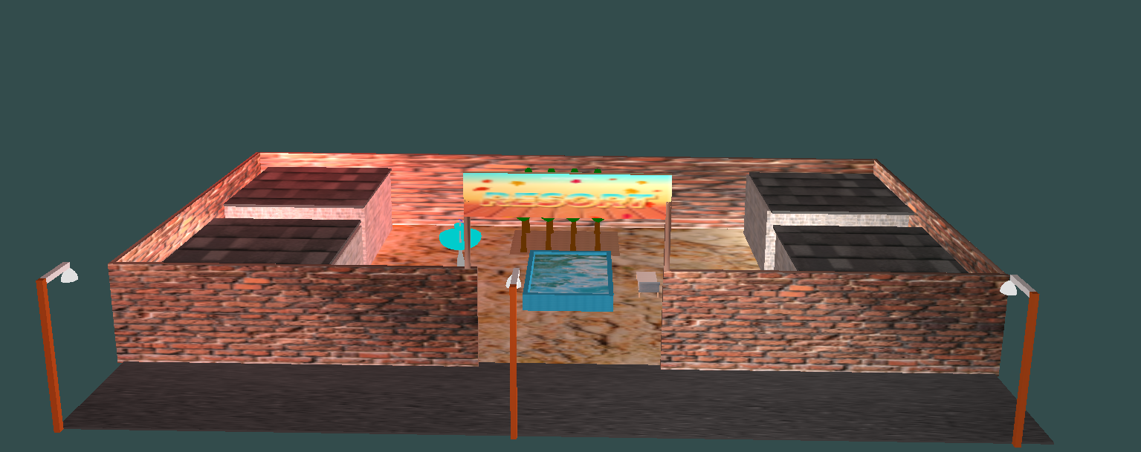
Features
Front View of 3D Resort
Figure 1.1: Front View

Slide 6
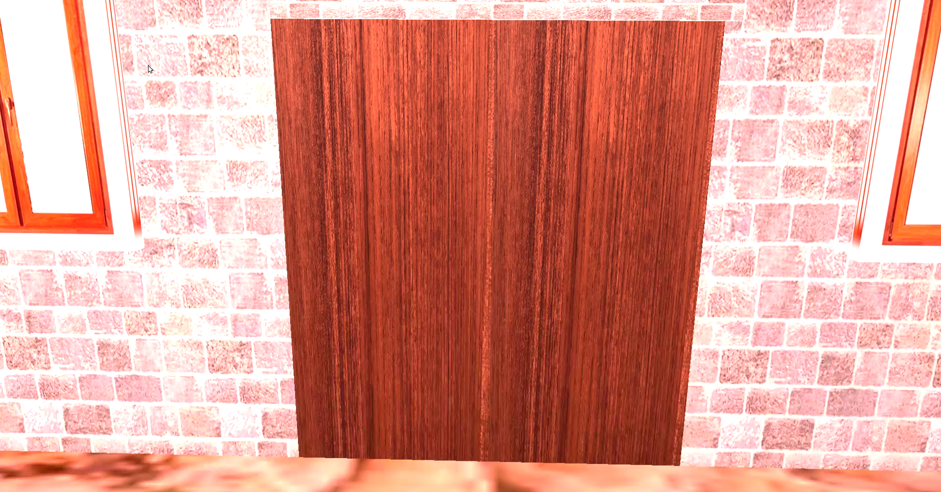
Features
Door Openning by pressing key “P”
Door Closing by pressing key “O”
Figure 1.2: Door openning and closing video

Slide 7
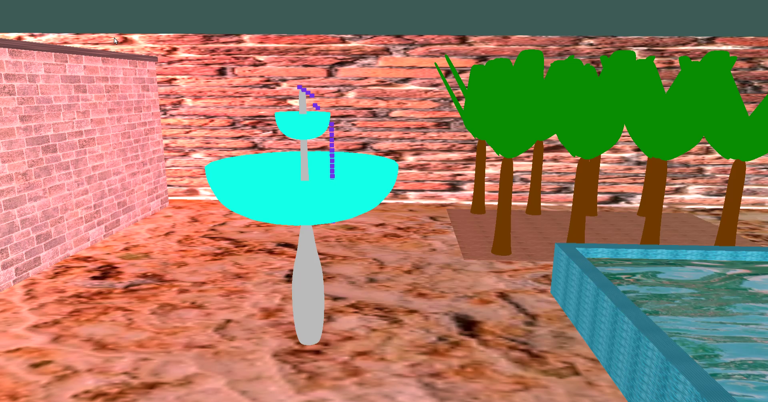
Features
Water fountain
Figure 1.3: Water Fountain

Slide 8
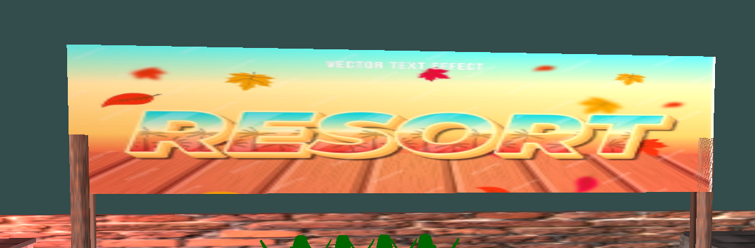
Features
Text texture
Figure 1.4: Text texture

Slide 9
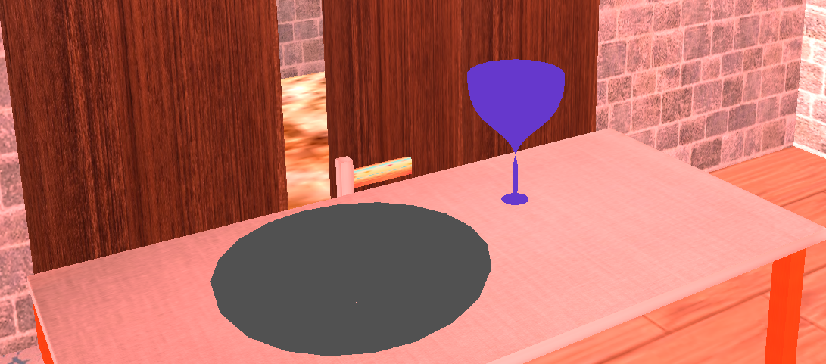
Features
Plate and wine glass using curve
Figure 1.5: Curve plate and wine glass

Slide 10
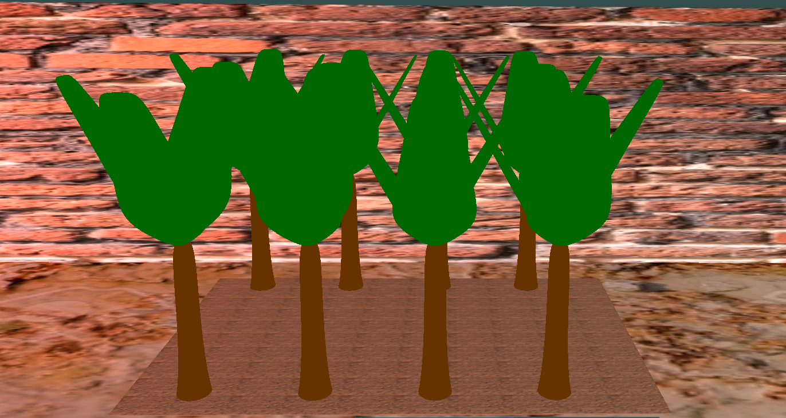
Features
Tree drawing using curve
Figure 1.6: Curve Trees

Slide 11
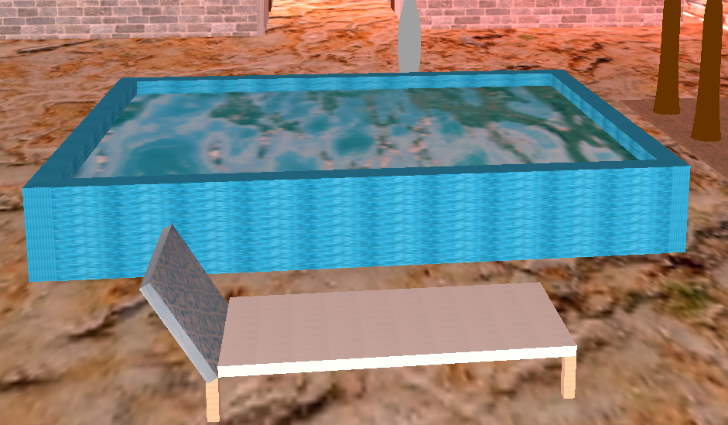
Features
Swimming pool with pool chair
Figure 1.7: Swimming pool and chair

Slide 12
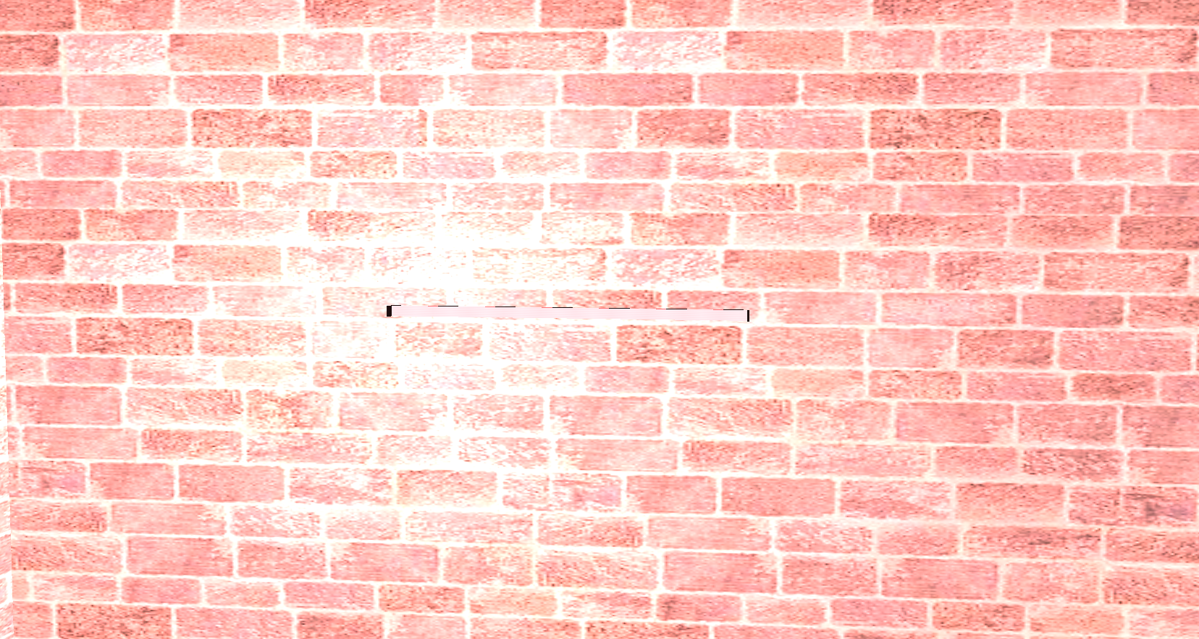
Features
Pointlight( Can be controlled by pressing key Z and X)
Figure 1.8: Pointlight

Slide 13
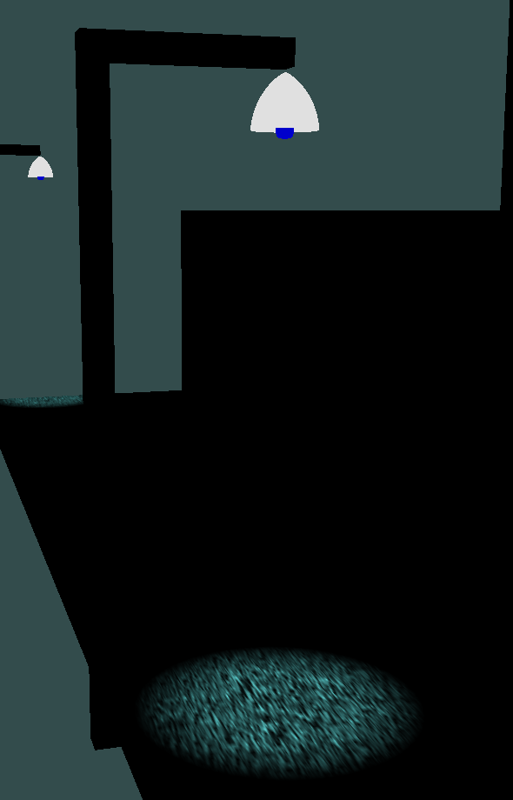
Features
Spotlight (Can be controlled by pressing key B and N)
Figure 1.9: Spotlight

Slide 14
Conclusion
Successfully implemented of a visually 3D Resort.
Texture mapping has been used to make objects realistic.
Successfully use curve to draw tress, plate and glass.

